Slide 1
Scientific article searching and classification

Slide 2
CyberBit team members: Balaskó László Feldman Dániel Halmágyi Zsolt Márk Gizella Noémi Sándor Annamária Coordinator: Bodó Zalán

Slide 3
Project’s goal
Download PDFs from a given domain using a crawler
Get the font and text features from the PDF document
Classify the document: is scientific?
Building the training set
Searching features and TF-IDF
Testing different types of learning algorithms

Slide 4







Used technologies
crawler4j

Slide 5
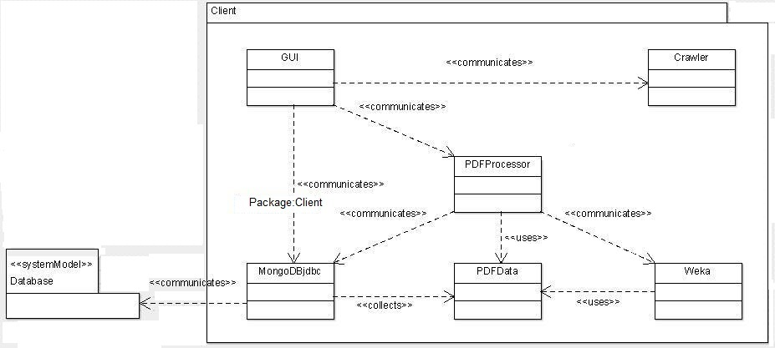
Architecture

Slide 6
Main functionalities
User interface: Balaskó László, Feldman Dániel
Crawler: Márk Gizella Noémi, Sándor Annamária
Font and text features of a PDF document: Balaskó László, Halmágyi Zsolt
MongoDB: Márk Gizella Noémi, Sándor Annamária
TF-IDF: Halmágyi Zsolt
Weka (Learning algorithms): Feldman Dániel

Slide 7
Problems and challenges occurred during the development
Balaskó László – PDFBox: text font-size
Feldman Dániel – Weka: reflection
Halmágyi Zsolt – TF-IDF: choosing specific words

Slide 8
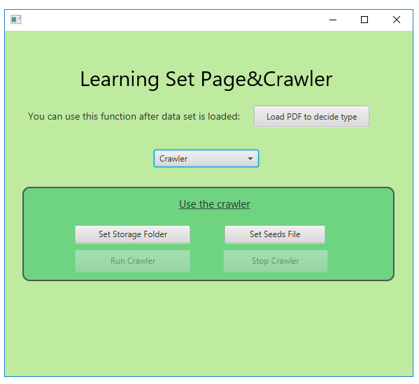
Demo

Slide 9
Thank you for your attention!
Questions?
Remarks?

